Slide 1
Accelerated Database Recovery (ADR)
Haripriya Naidu
Lead Database Reliability Engineer
SQL Saturday Boston – October 3rd, 2026

Slide 2




Haripriya Naidu
Database Reliability Engineer
12 years
Speaker
Blogger
  gohigh.substack.com
  linkedin.com/in/haripriya-naidu1215/
  github.com/haripriyasb/ADR

Slide 3
Agenda
What is ADR
How it works
Benefits
Trade-Offs
Demo

Slide 4
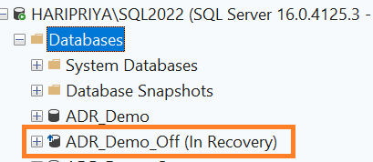
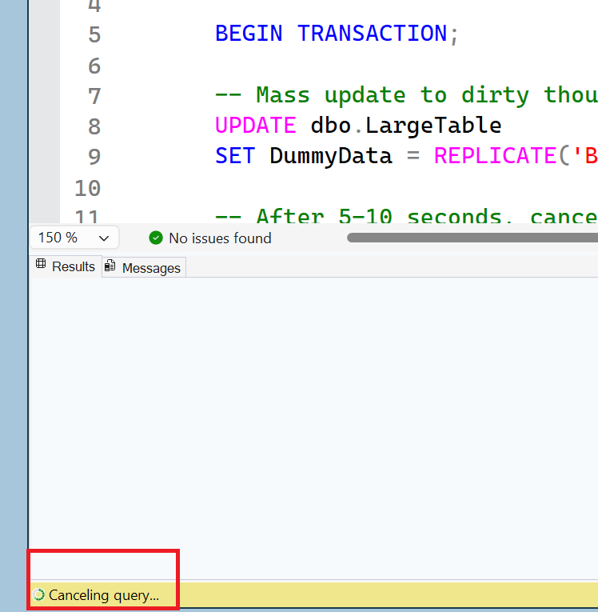
Pain point

Slide 5
Traditional Recovery Process
ARIES Model
Phase 1: Analysis
Scans forward from the last checkpoint to identify what belongs to the Redo and Undo processes
Phase 2: Redo
Commit to data pages
Phase3: Undo
Rollback uncommitted Tx
Log
Start
Oldest uncommitted Tx
Checkpoint
Log End
DB is available only after UNDO finishes

Slide 6
Unexpected restart / crash occurs
Analysis Phase
Forward scan of transaction log from last successful checkpoint or oldest dirty page LSN, to the end
Determine state of each transaction at the time engine stopped: committed vs still active
Redo Phase
Forward scan of transaction log from oldest uncommitted transaction to the end
Redo all committed operations to restore database to state at time of crash
Undo Phase
For each transaction active at crash time
Traverse log backward for that transaction
Undo the operations it performed
Database comes online only after Undo phase completes
Recovery time is roughly proportional to the size of the longest active transaction. Log can't be truncated while long-running transactions are active, since their log records are needed for redo/undo.

Slide 7
ADR
New database engine feature starting SQL 2019
Available in both Standard or Enterprise editions
Disabled by default in SQL Server
Enabled by default in Azure SQL Database, Azure SQL Managed Instance, and SQL database in Fabric
Speeds up the database availability by redesigning the recovery process
Fast and Consistent Database Recovery
Instantaneous Transaction Rollback
Aggressive Log Truncation

Slide 8
Enable ADR
Exclusive access to the database
ALTER DATABASE ADR_Demo_On SET ACCELERATED_DATABASE_RECOVERY = ON;
SELECT
name,
is_accelerated_database_recovery_on
FROM sys.databases;

Slide 9
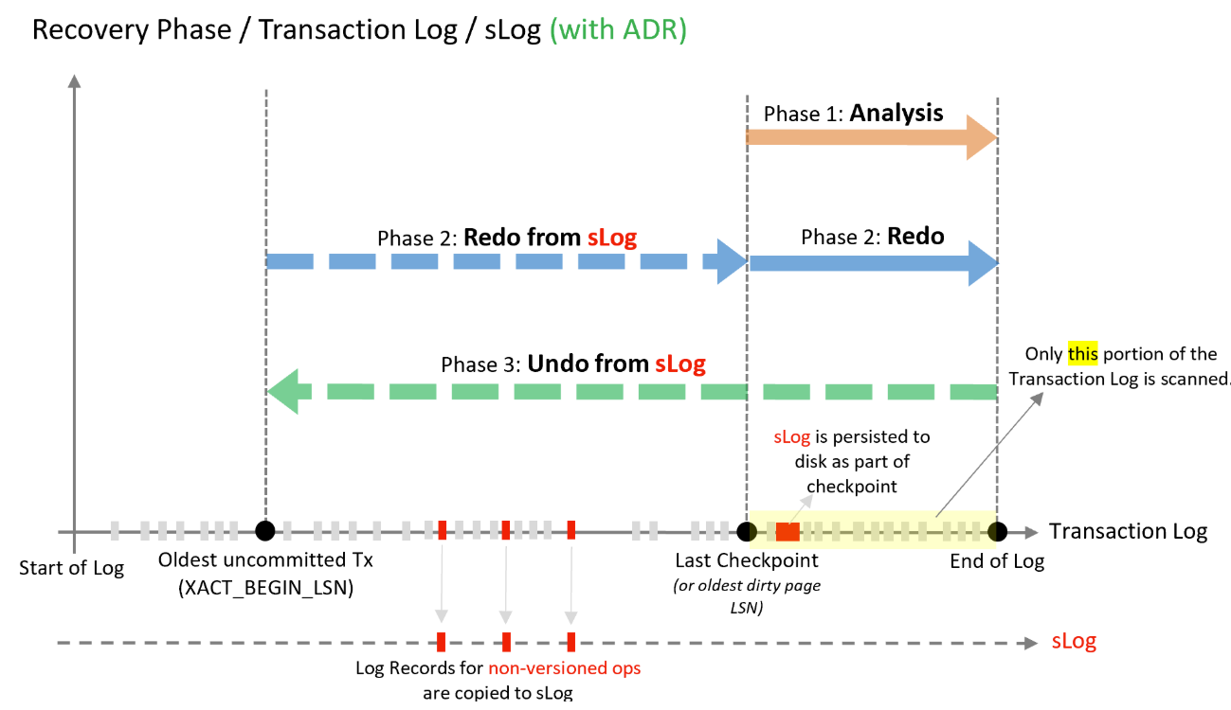
Recovery with ADR

Slide 10
ADR - Recovery Process Flow
ANALYSIS PHASE
REDO PHASE
UNDO PHASE
(near-instantaneous)
BACKGROUND CLEANUP
(async, after online)
Unexpected restart / crash occurs
Forward scan of transaction log from last successful checkpoint (or oldest dirty-page LSN) to the end - same as traditional recovery
Subphase 1: redo from the SLOG’s oldest uncommitted transaction up to the last checkpoint - fast, few records to process
Mark every transaction in the ATT as ABORTED
Logical Revert - async, runs in background after the database is already online
Versioned ops: aborted transactions' row versions in the PVS are ignored by queries - no physical undo needed yet
Non-versioned ops: undo using the SLOG almost instantly
Uses the PVS to perform row-level, version-based undo for all aborted transactions - locks already released
PLUS: reconstruct the SLOG secondary log stream by copying log records for non-versioned operations
Subphase 2: redo from the transaction log starting at the last successful checkpoint - not from the oldest uncommitted transaction
Database comes online as soon as the Undo phase completes - not blocked by size or count of active transactions
PVS Cleaner - async, periodic; removes obsolete/aborted row versions from the PVS
Build the Active Transaction Table (ATT), identifying transactions active at crash time - not yet aborted
Note: recovery time is constant — not affected by the number or size of active transactions at crash time. Log is only processed from the last checkpoint, not the oldest active transaction.

Slide 11
Unexpected restart / crash occurs
Analysis Phase
Forward scan of transaction log from last successful checkpoint or oldest dirty page LSN, to the end
Reconstruct SLOG – copy log records for
nonversioned operations
Reconstruct SLOG – copy log records for nonversioned operations
Redo Phase
Subpahes1: Redo from SLOG
From oldest uncommitted transaction to last checkpoint
Subphase2: Redo from Tlog
From starting from last checkpoint
Undo Phase - Instantaneous
UNDO using SLOG + PVS in the background
Traverse log backward for that transaction
Undo the operations it performed
Database comes online only after Undo phase completes
Recovery time is roughly proportional to the size of the longest active transaction. Log can't be truncated while long-running transactions are active, since their log records are needed for redo/undo.

Slide 12
Components of ADR
Persistent Version Store - PVS
Logical Revert
Secondary Log – sLog
Cleanup

Slide 13
Secondary Log - sLog
Secondary log - in memory, stores log records for non-versioned operations
Built continuously at runtime whenever ADR is enabled
Persists on disk during checkpoint
Truncates after transaction commits
Speeds up redo and undo by processing non-versioned operations

Slide 14
Version Store vs Persistent Version Store
< Explain what the difference is>

Slide 15
Persistent Version Store - PVS
When DML runs, it persists row versions in the user database itself
Traditional way - version store in the tempdb database.
Row versions are in data pages being modified, or in a separate system table.
Availability Group aware - improves availability of readable secondaries.

Slide 16
Logical Revert
Asynchronous process
Row-level version-based undo
Instant transaction rollback and undo
for all versioned operations.
Keeps track of all aborted transactions
and revert their versions
Releases all locks immediately after
transaction abort
PVS
Copies last committed version
Data pages

Slide 17
Cleanup
Asynchronous process
Wakes up periodically and cleans obsolete row versions from PVS
SQL 2022 - Increase ADR cleaner thread count if DMLs are high

Slide 18
ADR’s Core Trick - Version Everything
PVS (Persistent Version Store): row versions stored inside the DB, not tempdb
SLOG (Secondary Log Stream): lightweight in-memory stream for non-versioned ops only
Logical revert: undo is asynchronous via PVS, instant from the user's view
Aborted transactions are marked immediately; concurrent queries just ignore their versions
Recovery time becomes CONSTANT, log size no longer matters

Slide 19
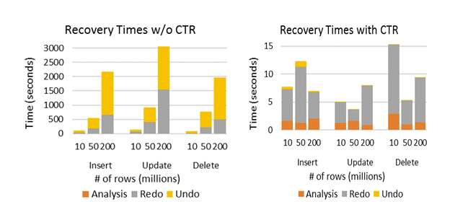
Constant Time Recovery
https://www.microsoft.com/en-us/research/publication/constant-time-recovery-in-azure-sql-database/

Slide 20
Aggressive Log Truncation
Versioned operations are stored in PVS
Non-versioned operations are stored in SLOG
Log doesn’t not need to be retained for UNDO

Slide 21
Workloads that benefit from ADR
Long-running transactions.
Active transactions that cause the transaction log to grow significantly.
Long periods of database unavailability due to long running recovery (such as from unexpected service restart or manual transaction rollback).

Slide 22
Best Practices for ADR
Space in the database to account for PVS usage
  DML might fail
Replication or CDC – aggressive log truncation is disabled
  Make sure Tlog is large
In SQL 2022 – increase ADR cleaner thread count if DMLs are high

Slide 23
Monitoring and troubleshooting
<add dmvs and XE>

Slide 24
Watch out!
Do not enable ADR on TempDB
Latch contention on the sys.sysseobjvalues system table is YET to be resolved

Slide 25
DEMO

Slide 26
Takeaways

Slide 27
Resources
https://learn.microsoft.com/en-us/sql/relational-databases/accelerated-database-recovery-concepts?view=sql-server-ver17
https://learn.microsoft.com/en-us/sql/relational-databases/accelerated-database-recovery-troubleshoot?view=sql-server-ver17&tabs=sql-server-sql-mi
https://www.microsoft.com/en-us/research/publication/constant-time-recovery-in-azure-sql-database/
https://www.youtube.com/watch?v=ro-iryiNkrg

